Slide 1
Applying SVM-Based Trade Classification to Pairs Trading: Statistical Arbitrage
Bowen Zhao, Harsh Kulkarni
Oct 16th, 2025

Slide 2
Motivation & Project Goal
Motivation
Traditional pairs trading strategies rely on simple technical indicators (e.g., RSI, MACD) to detect mean reversion opportunities.
These methods are often noisy, lagging, and not adaptive to changing market regimes.
Modern markets are non-stationary, with structural breaks and volatility regime shifts → classical signals can degrade quickly.
By incorporating econometric spread dynamics, macro indicators, and Hidden Markov Models (HMM), we can capture richer structure in spread behavior.
Machine learning methods like SVM classifiers can learn nonlinear decision boundaries for trade selection.
Project Goal
Build a market-neutral statistical arbitrage strategy between cointegrated asset pairs.
Use Support Vector Machine (SVM) classifiers to predict the profitability of mean-reversion trades.
Replace simple indicators with a feature set based on:
  Econometric statistics (Ornstein–Uhlenbeck process parameters, stationarity tests, Hurst exponent).
  HMM regime probabilities for spread returns.
  Macro indicators (e.g., VIX, yield curve spreads).
Generate labels through simulated PnL of simple z-score mean reversion trades → train two SVMs (long & short).

Slide 3
Data Collection
Select ~10 liquid, same-sector asset pairs (e.g., JPM–BAC, KO–PEP) to ensure comparable fundamentals and stable relationships.
Download adjusted close prices (hourly or daily) and convert to log prices for linearity and variance stabilization.
Align timestamps across assets, handle holidays and missing data carefully.
Collect macroeconomic indicators to enrich the feature space:
VIX Index (volatility proxy)
10Y–2Y Treasury yield spread (macro regime indicator)
Resample and forward-fill macro data to match the frequency of price data.

Slide 4
Pair Selection
Apply a rolling 60-day correlation filter to identify highly correlated asset pairs (threshold ≥ 0.75).
Perform the Engle–Granger cointegration test on each pair:
  Regress one asset’s log price on the other to obtain residuals.
  Apply the ADF test on residuals; select pairs with p-value < 0.05 to ensure stationarity.
Recalculate cointegration and stationarity monthly to maintain robustness.
Estimate Ornstein–Uhlenbeck (OU) process parameters (κ, μ, σ) for each pair to assess mean reversion characteristics.
Filter pairs based on OU half-life and stability of parameters.

Slide 5
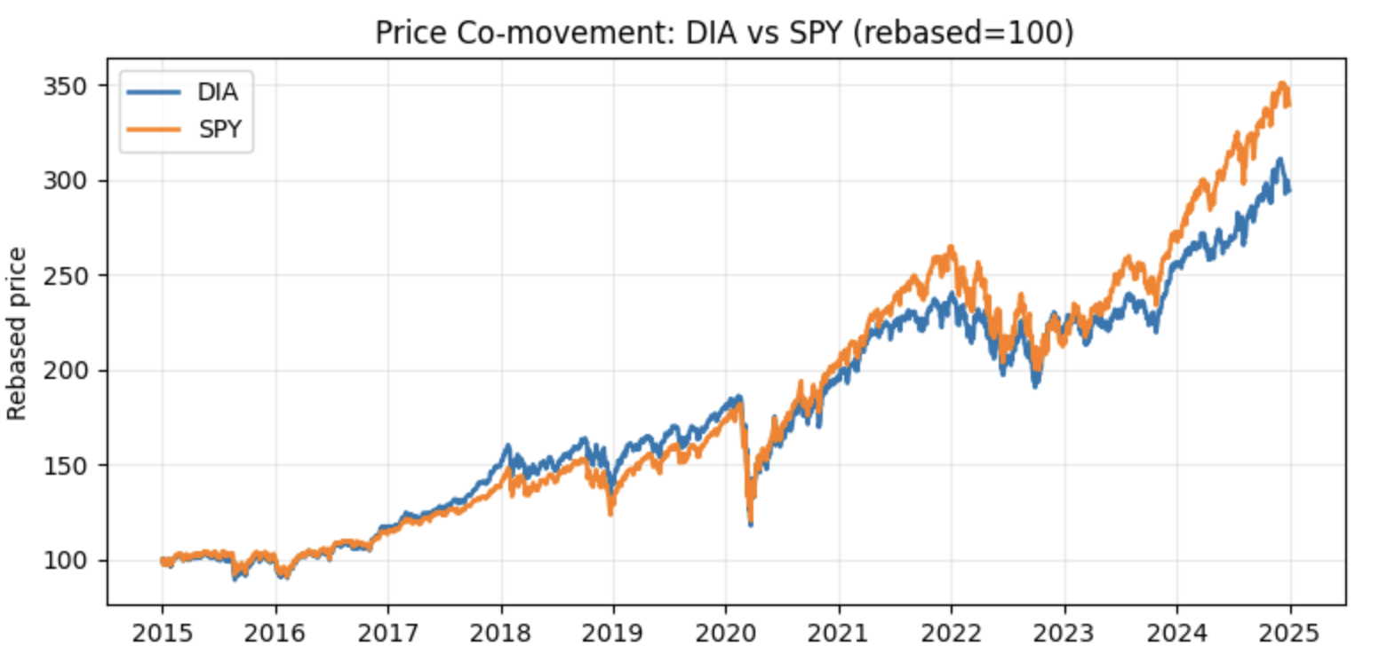
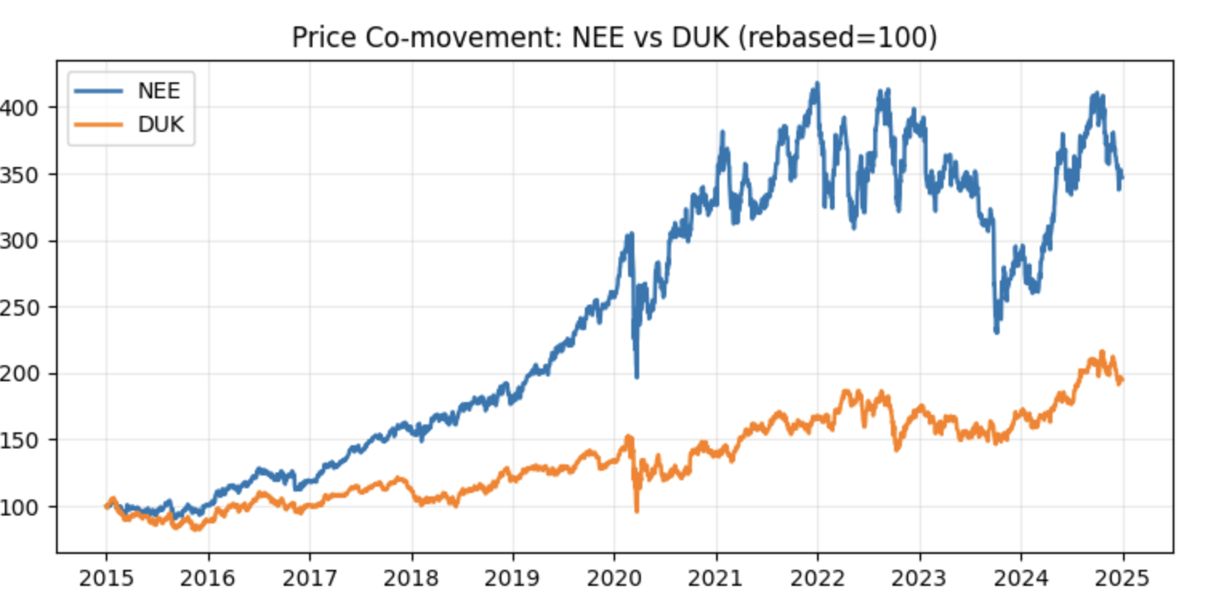
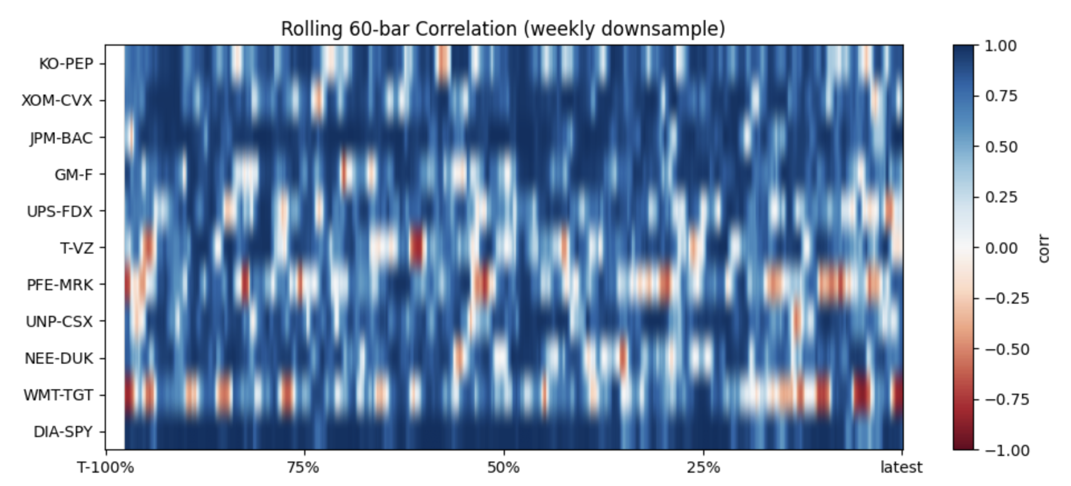
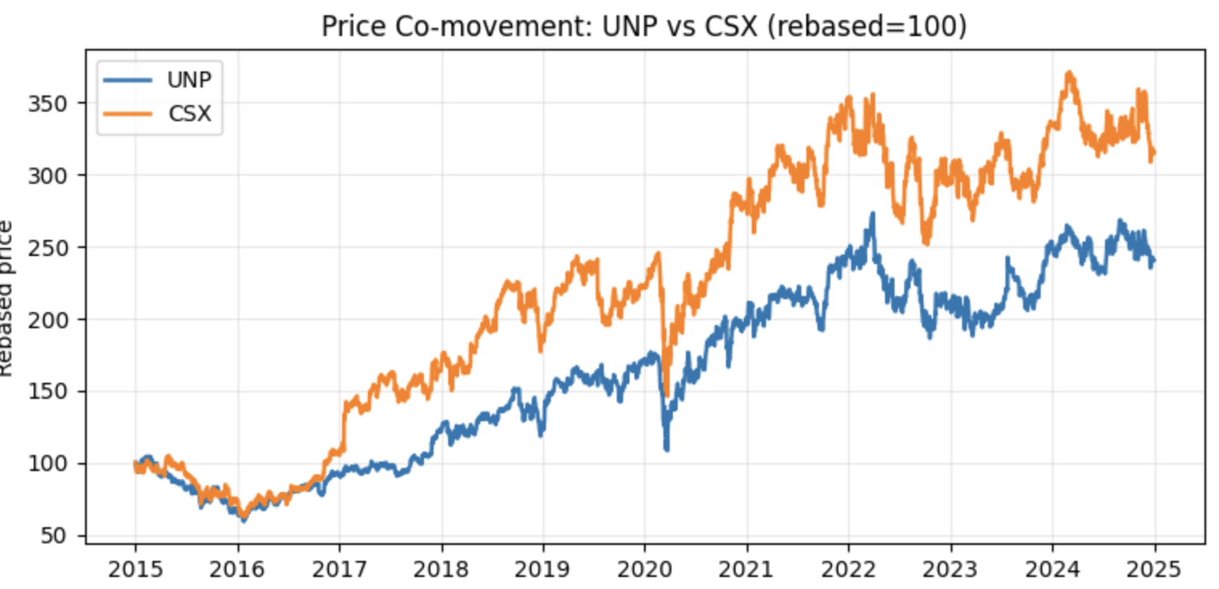
Pair Selection - Visualization

Slide 6
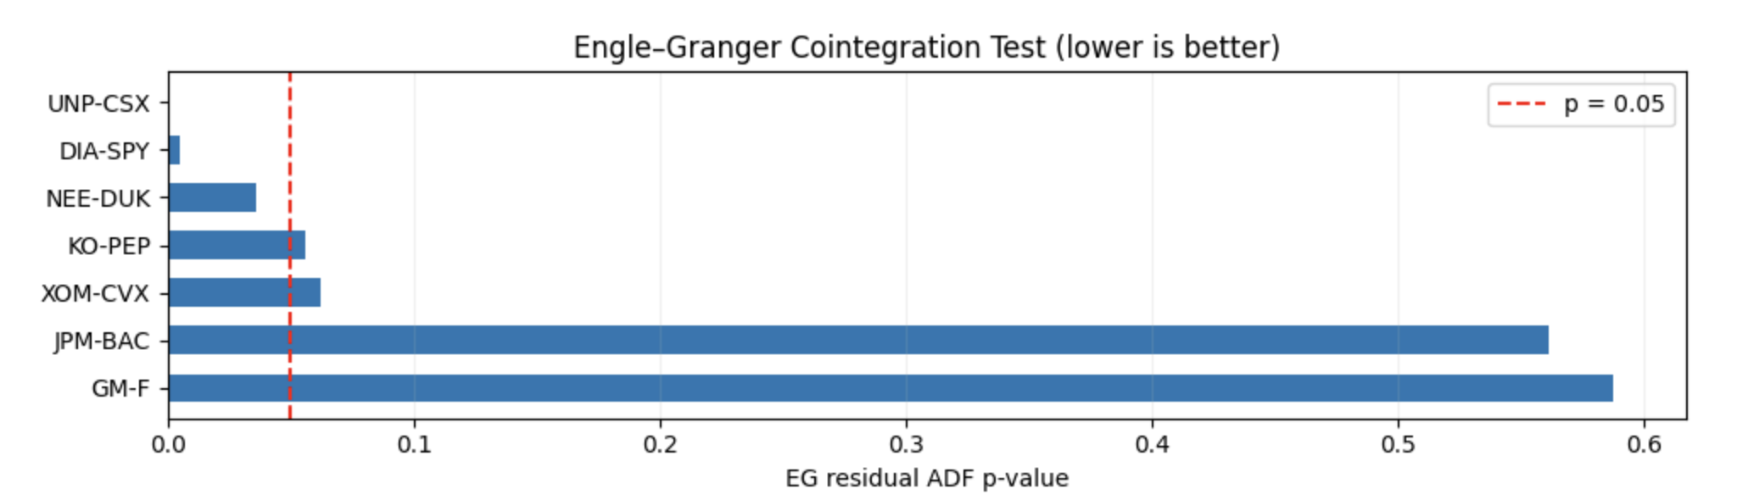
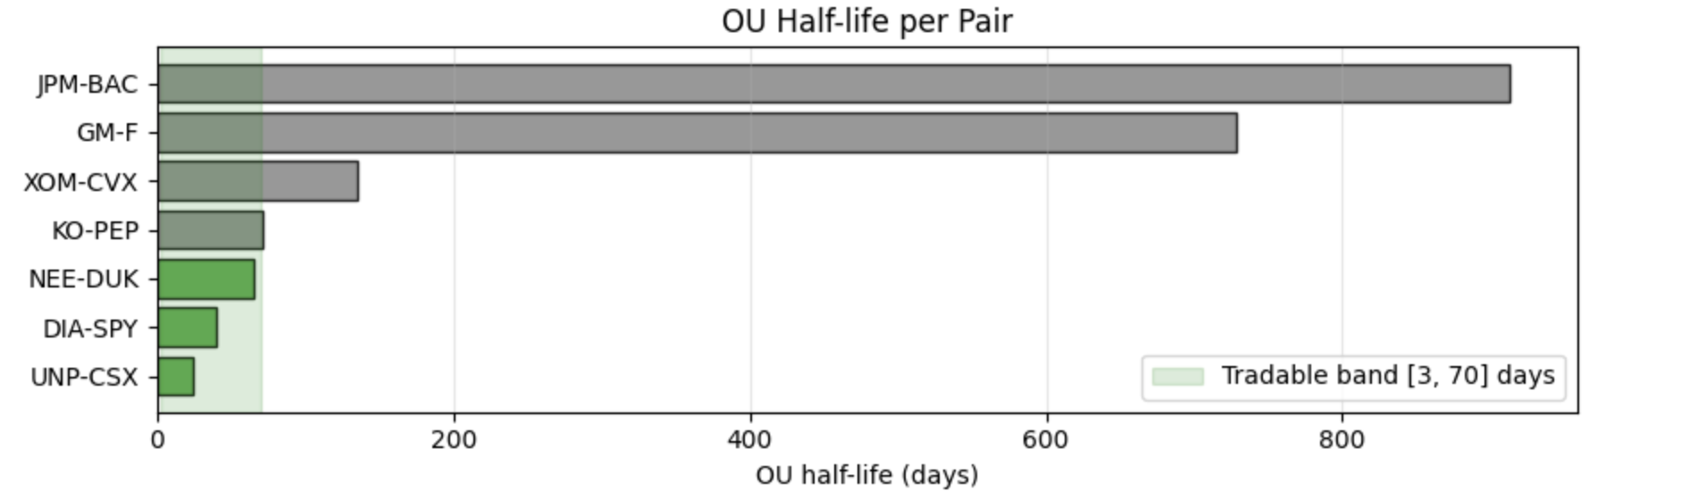
Pair Selection - Visualization

Slide 7

Feature Engineering
Construct predictive features from three categories to capture spread behavior beyond simple technical indicators:
Econometric Features
  Estimate parameters of the Ornstein–Uhlenbeck (OU) process fitted to the spread:
  Extract κ (speed of mean reversion), μ (long-term mean), σ (volatility).
  Additional statistics: ADF t-statistics, Hurst exponent, short-term momentum.
Hidden Markov Model (HMM) Regime Features
  Fit a 2–3 state Gaussian HMM to spread returns.
  Compute state probabilities for each time point to characterize regimes (e.g., trending vs mean-reverting)
Macro Features
  Include contemporaneous macro indicators (e.g., VIX, yield curve spread) to reflect market conditions.

Slide 8
Label Generation
Generate supervised learning labels by simulating simple mean reversion trades on the spread, based on z-score signals.
For each pair, compute the spread and its rolling mean and standard deviation. Then calculate the z-score
Entry and exit rules:
  Enter Long if z_t ≤ −1.5
  Enter Short if z_t ≥ +1.5
  Take Profit at z=0, Stop Loss at ±2.5
For each signal, label:
  +1 if the trade hits take profit before stop loss
  −1 otherwise
Separate labels for long and short signals to train two classifiers (SVM-Long, SVM-Short).

Slide 9
Walk-Forward Data Splitting
Apply a walk-forward (rolling window) approach to avoid look-ahead bias and reflect realistic model deployment.
Split the dataset into training and testing windows that slide through time:
Training Window: Past N = 750 observations (≈ 3 years)
Testing Window: Next M = 252 observations (≈ 6–12 months)
Label Buffer: ~30 bars between train and test to prevent label leakage
At each iteration (fold):
Fit separate SVM models for long and short trades using only past data.
Calibrate model outputs to obtain probabilistic scores (p_profit).
Determine a ROC-optimal probability threshold on a validation slice within the training window.
Evaluate the calibrated models on the next unseen test window.
Move the window forward and repeat.
This method preserves temporal ordering, ensures no data leakage, and mimics live retraining with dynamic probability calibration per fold.

Slide 10
Backtest Trading Logic
Implement a live trading simulation using model predictions and z-score signals.
At each time step:
Compute spread, z-score, and features (252-bar hedge ratio, 60-bar z-score).
If |z| ≥ entry threshold, raise a signal.
Side: long if z < 0, short if z > 0.
Get calibrated SVM probability for that side, weighted by HMM mean-reversion prob.
Enter, if the effective probability clears the threshold (ROC-optimal per fold/side or top-20% quantile).
Manage the open trade each bar:
  Take profit when z -> 0,
  Stop loss if z moves further past entry,
  Exit on max holding time.
Hyperparameters to tune: Entry z-score threshold, Take-profit and stop-loss levels, Max holding time

Slide 11
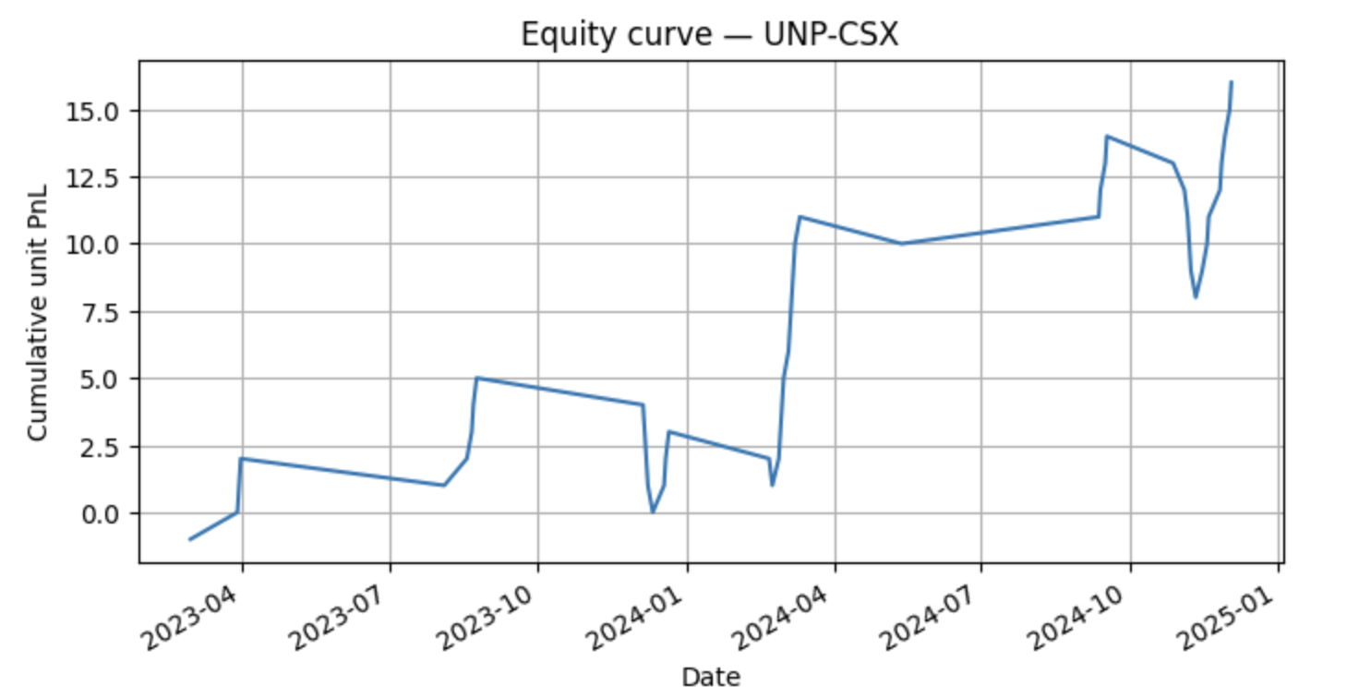
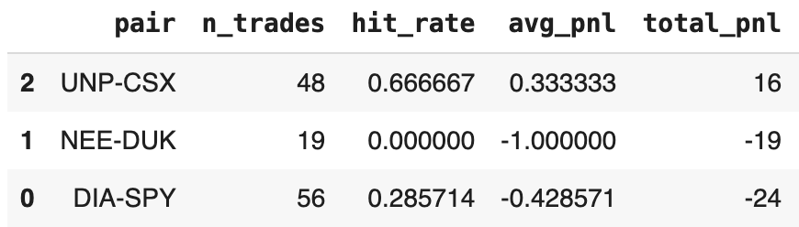
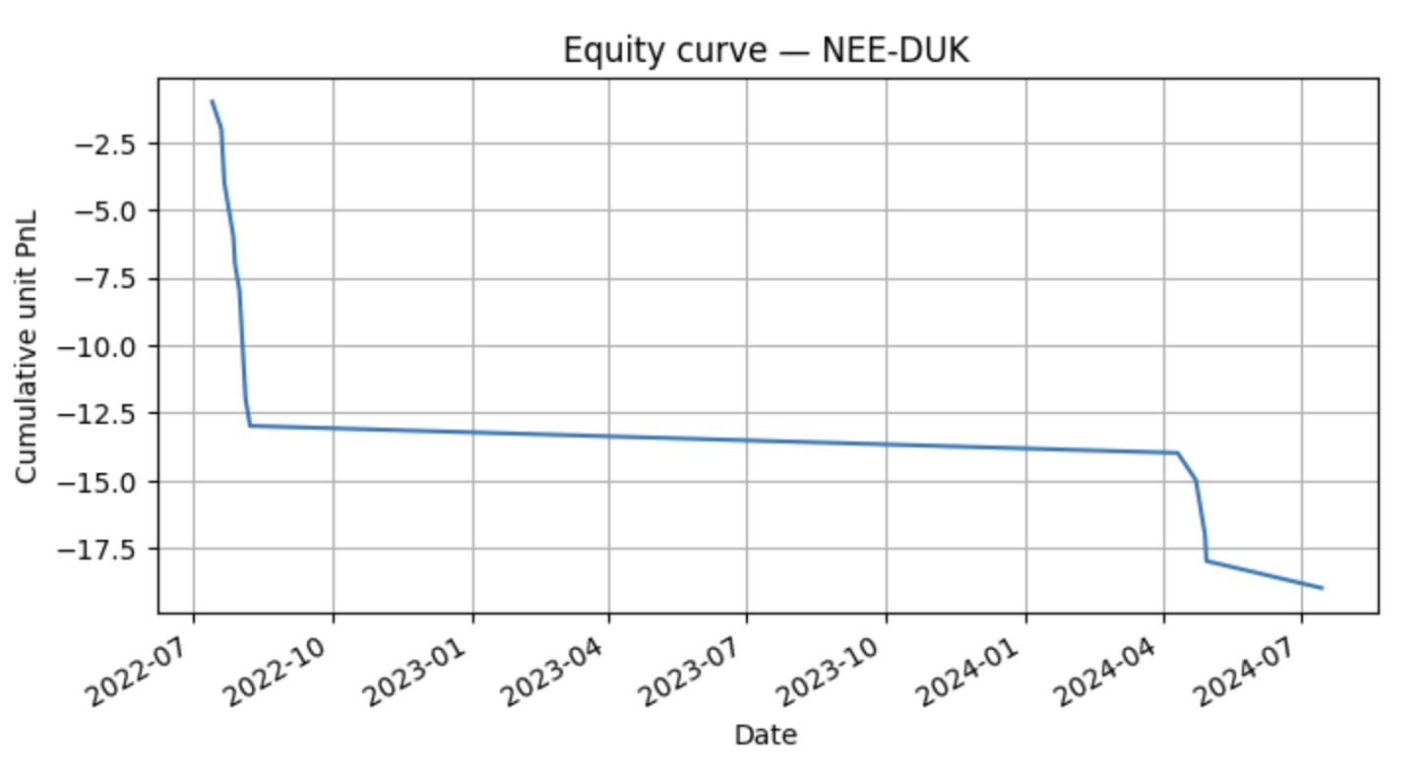
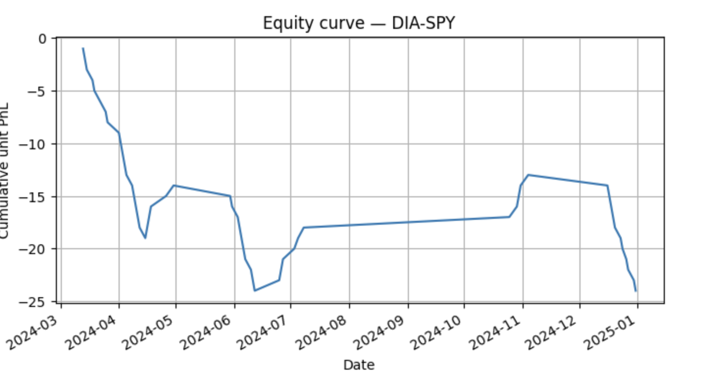
Backtest Results
The strategy was evaluated on three final pairs (DIA–SPY, UNP–CSX, NEE–DUK)
Key Findings:
UNP–CSX achieved strong mean-reversion behavior, with a 67% hit rate and positive total PnL.
DIA–SPY, a benchmark pair, traded frequently but underperformed
NEE–DUK exhibited no profitable signals

Slide 12
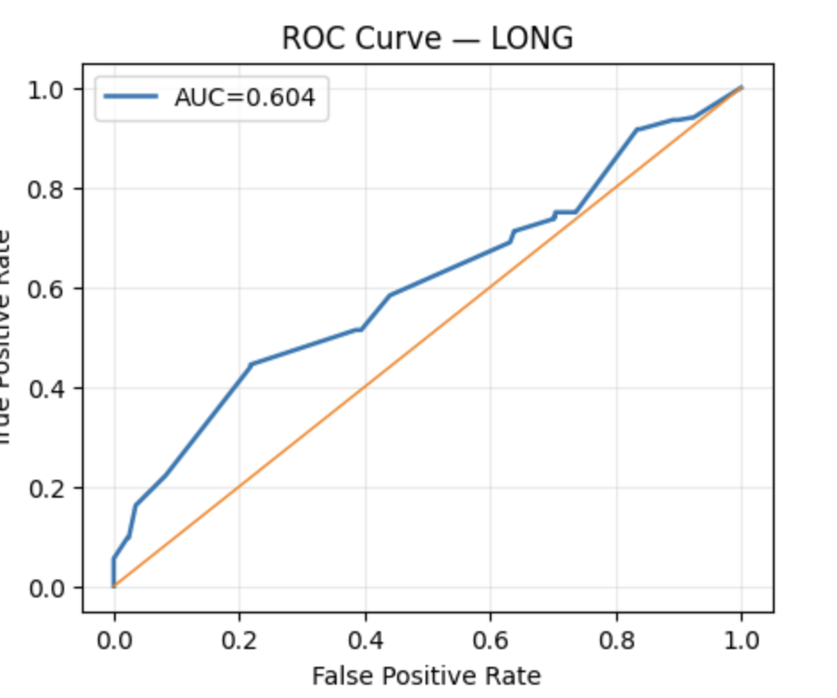
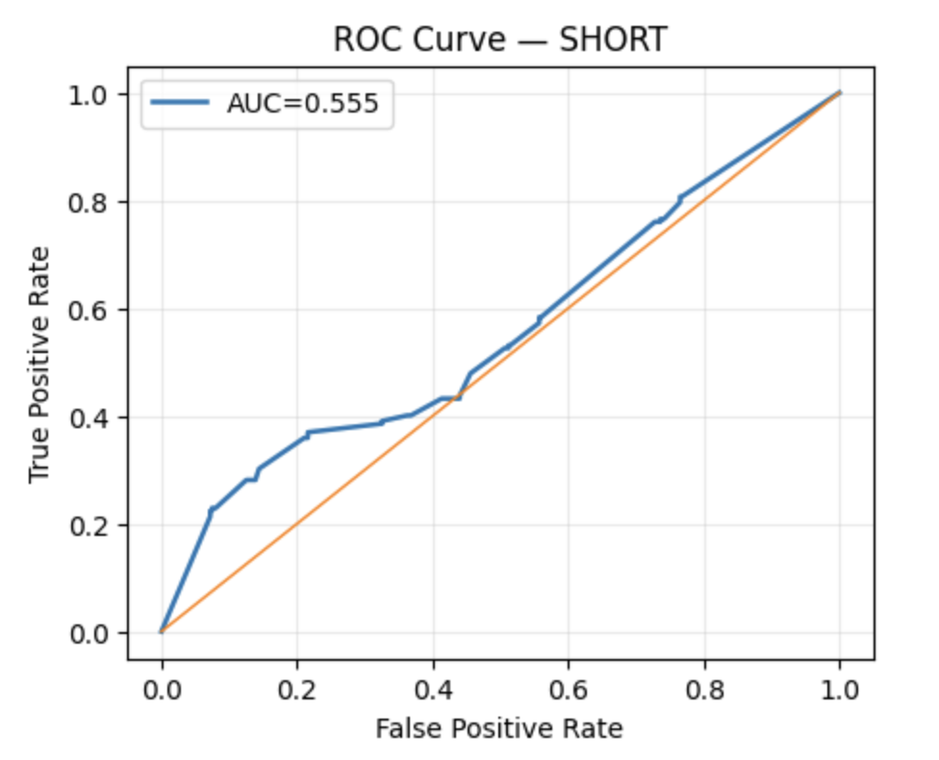
Interpretation
Model behavior shows statistical validity despite low profitability.
The ROC curves (AUC ≈ 0.60) demonstrate that the SVM distinguishes profitable from unprofitable trades better than random, which means it’s a weak but genuine predictive signal
The equity curves shown earlier evolve smoothly, without erratic jumps, showing the model reacts systematically rather than randomly.
The per-pair results highlight that signal strength varies by market — UNP–CSX mean-reverted successfully, while others lagged due to slower or unstable spreads.
Therefore, even though the total PnL < 0, the ROC curve shows us that the model has directional awareness of profitable conditions and that the framework works, but execution and parameter tuning need refinement.

Slide 13
Conclusion and Future Work
We,
Investigated pairs trading performance in different market regimes using a regime-aware SVM framework, integrating econometric features, HMM state probabilities, and back tested trading signals.
Demonstrated weak but consistent predictive power (AUC ≈ 0.6) with our strategy, confirming that mean-reversion structure exists even though total PnL remains modest.
Implemented Walk-forward design and ROC-based evaluation ensured no look-ahead bias and realistic deployment behavior.
HMM regimes aligned with volatility clustering, validating the market-state interpretation.
Future Work:
Hyperparameter Tuning: Refine z-score thresholds, stop-loss/take-profit bands, and SVM parameters (C, gamma).
Regime-Specific Models: Train separate SVMs for each HMM regime to capture regime-dependent behavior.
Execution Layer: Account for transaction costs and slippage to evaluate real-world performance.

